Slide 1
Capstone project
Machine learning fundamentals
LUIGI MARONGIU
Jan-Feb 2019

Slide 2
Table of contents
Data exploration
Questions
Methods
Results
Discussion
Conclusions

Slide 3
Data Exploration
Overview of the dataset
Total number of fields: 31 Total number of records: 59,946 Note: ‘object’ = free text
Field | Records | Type |  | Field | Records | Type
age | 59946 | int64 |  | ethnicity | 54266 | object
body_type | 54650 | object |  | height | 59943 | float64
diet | 35551 | object |  | income | 59946 | int64
drinks | 56961 | object |  | job | 51748 | object
drugs | 45866 | object |  | last_online | 59946 | object
education | 53318 | object |  | location | 59946 | object
essay0 | 54458 | object |  | offspring | 24385 | object
essay1 | 52374 | object |  | orientation | 59946 | object
essay2 | 50308 | object |  | pets | 40025 | object
essay3 | 48470 | object |  | religion | 39720 | object
essay4 | 49409 | object |  | sex | 59946 | object
essay5 | 49096 | object |  | sign | 48890 | object
essay6 | 46175 | object |  | smokes | 54434 | object
essay7 | 47495 | object |  | speaks | 59896 | object
essay8 | 40721 | object |  | status | 59946 | object
essay9 | 47343 | object

Slide 4
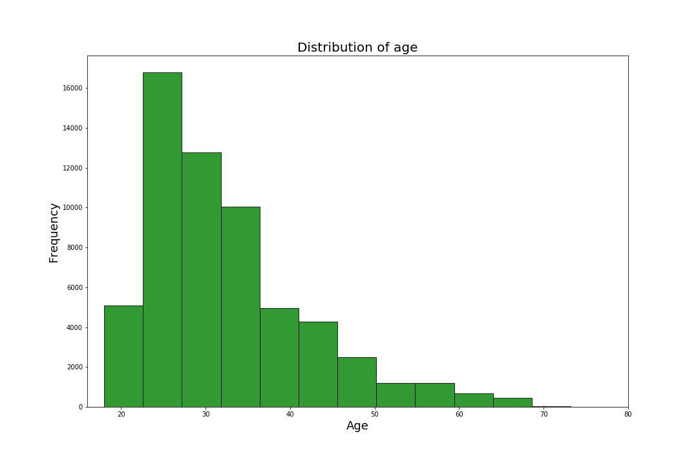
Data Exploration
Age distribution of the dataset

Slide 5
Data Exploration
None of the variable pairs showed high linear correlation, normalization did not affect data
Before normalization | age | height | income | drink_code | smoke_code | drug_code | essay_len | avg_word_length
age | 1 | -0.01 | 0.02 | -0.10 | -0.17 | -0.15 | 0.11 | 0.04
height | -0.01 | 1 | 0.11 | 0.04 | 0.04 | 0.08 | -0.01 | 0.02
income | 0.02 | 0.11 | 1 | 0.00 | 0.07 | 0.08 | 0.01 | -0.02
drink_code | -0.10 | 0.04 | 0.00 | 1 | 0.16 | 0.22 | -0.03 | 0.01
smoke_code | -0.17 | 0.04 | 0.07 | 0.16 | 1 | 0.35 | -0.09 | -0.04
drug_code | -0.15 | 0.08 | 0.08 | 0.22 | 0.35 | 1 | 0.06 | 0.12
essay_len | 0.11 | -0.01 | 0.01 | -0.03 | -0.09 | 0.06 | 1 | 0.39
avg_word_length | 0.04 | 0.02 | -0.02 | 0.01 | -0.04 | 0.12 | 0.39 | 1
After normalization | age | height | income | smoke_code | drink_code | drug_code | essay_len | avg_word_length
age | 1 | -0.01 | 0.02 | -0.17 | -0.10 | -0.15 | 0.11 | 0.04
height | -0.01 | 1 | 0.11 | 0.04 | 0.04 | 0.08 | -0.01 | 0.02
income | 0.02 | 0.11 | 1 | 0.07 | 0.00 | 0.08 | 0.01 | -0.02
smoke_code | -0.17 | 0.04 | 0.07 | 1 | 0.16 | 0.35 | -0.09 | -0.04
drink_code | -0.10 | 0.04 | 0.00 | 0.16 | 1 | 0.22 | -0.03 | 0.01
drug_code | -0.15 | 0.08 | 0.08 | 0.35 | 0.22 | 1 | 0.06 | 0.12
essay_len | 0.11 | -0.01 | 0.01 | -0.09 | -0.03 | 0.06 | 1 | 0.39
avg_word_length | 0.04 | 0.02 | -0.02 | -0.04 | 0.01 | 0.12 | 0.39 | 1

Slide 6
Data Exploration
Most of the data was categorical, I explored some combination to find pairs that could be used
I normalized the data
I created new columns where different labels were educed to more manageable ones*, such as in the zodiac case that follows…
* NOTE: more details on the procedure in later slides

Slide 7
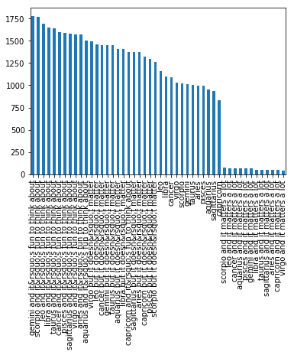
Data Exploration
Zodiac sign distribution of the dataset
(original classification)

Slide 8
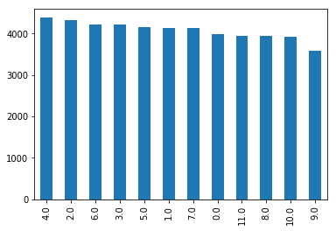
Data Exploration
Zodiac sign normalized entries
(new column: ‘zodiac’)
aries=0, taurus=1, gemini= 2, cancer=3, leo=4, virgo=5, libra=6, scorpio=7, sagittarius=8, capricorn=9, aquarius=10, pisces=11.
NOTE: all entries claiming one zodiac sign have been grouped into the same bin.

Slide 9
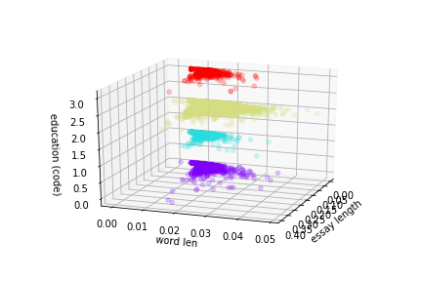
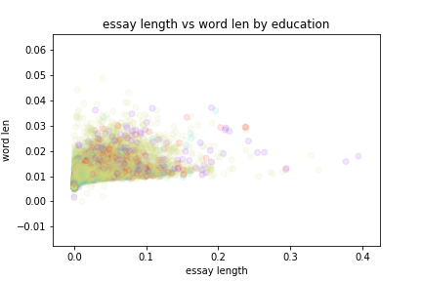
Data Exploration
‘Word mean length’ and ‘essay length’ were continuous variables good for regression modelling; ‘education’ could be used as a label since there is suggestion of a shift between classes, but the labels are too much overlapped for being useful.

Slide 10
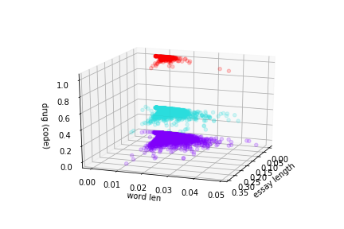
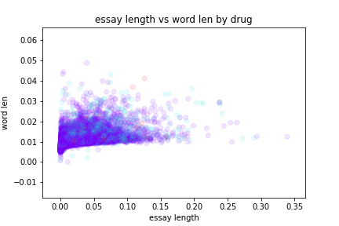
Data Exploration
It would have been interesting to address the relation between ‘essay length’ and ‘mean word length’ against ‘drug use’ but in this case the cluster was suboptimal

Slide 11
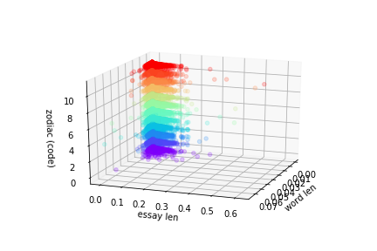
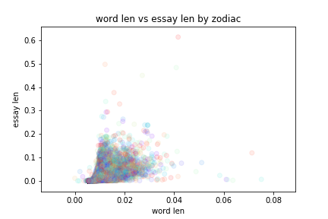
Data Exploration
It would have been interesting to address the relation between ‘essay length’ and ‘mean word length’ against ‘zodiac’ but in this case the cluster was sub-optimal

Slide 12
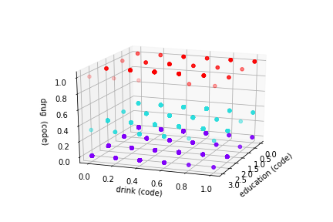
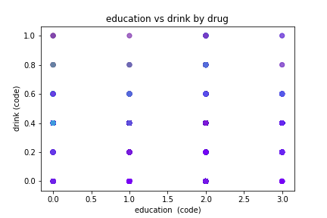
Data Exploration
It would be interest to model ‘drink’ and ‘drug’ habit to ‘education’, but the data did not show particular trends.

Slide 13
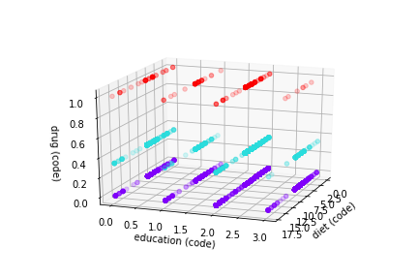
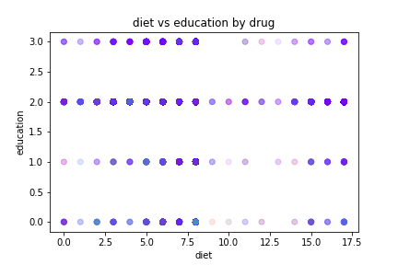
Data Exploration
Another possibility was ‘diet’ against ‘education’ with a label on ‘drug’, which is not great in terms of visible trends. Permutations of axis or other variables did not show trends anyway.

Slide 14
Questions
Based on the data at hand, I set the following questions:
a) is there a correlation between ‘essay length’ and ‘mean word length’?
b) and between ‘essay length’ and ‘mean word length’ considering ‘education’?
c) is it possible to predict ‘zodiac’ sign based on ‘essay length’ and ‘mean word length’?
d) is it possible to predict ‘drug’ habit based on ‘essay length’ and ‘mean word length’?

Slide 15
Questions
The questions were based on the assumption that people with higher education might choose fancier words, which are expected to be longer than common ones, and articulate thoughts in longer phrases.
On the contrary, zodiac sign was not expected to have any impact on people’s knowledge or writing skills.
For the regression analysis, the only two continuous variables were assessed.

Slide 16
Methods
To address question (a) I used linear regression
To address question (b) I used multinomial regression
To address questions (c) and (d) I used K-Means++ Clustering and Support Vector Machine

Slide 17
Methods
I augmented the data by creating new columns containing re-decoded values; I re-decoded all categorical data but here I am showing the fields used in the analysis.
edu_map = {
'working on ph.d program':3,'graduated from ph.d program':3,'ph.d program':3,\
'law school''med school':2, 'masters program':2,'working on college/university':2,\
'college/university':2,'two-year college':2,\
'graduated from masters program':2,'graduated from two-year college':2,\
'graduated from college/university':2,'working on two-year college':2,\
'graduated from law school':2,'working on masters program':2,\
'graduated from med school':2,\
'graduated from space camp':2,'working on med school':2,'working on law school':2,\
'graduated from high school':1,'space camp':1,'working on space camp':1,\
'working on high school':1,'high school':1,\
'dropped out of college/university':0,'dropped out of space camp':0,\
'dropped out of high school':0,'dropped out of med school':0,'dropped out of law school':0,\
'dropped out of masters program':0,'dropped out of ph.d program':0,\
'dropped out of two-year college':0
}
df["edu_cp"] = df.edu_cp.map(edu_map)
drugs_mapping = {"never":0, "sometimes":1, "often":3}
df["smoke_code"] = df.smokes.map(smokes_mapping)

Slide 18
Methods
...continued
sign_mapping = {"aries": 0, "taurus": 1, "gemini":2, "cancer":3, \
"leo":4, "virgo":5, "libra": 6, "scorpio":7, "sagittarius":8, \
"capricorn":9, "aquarius":10, "pisces":11, \
'pisces but it doesn&rsquo;t matter':11, \
'gemini but it doesn&rsquo;t matter': 2, \
'cancer but it doesn&rsquo;t matter': 3, \
'leo but it doesn&rsquo;t matter': 4, \
'aquarius but it doesn&rsquo;t matter': 10, \
'aries and it&rsquo;s fun to think about': 0,
'libra but it doesn&rsquo;t matter': 6, \
'pisces and it&rsquo;s fun to think about': 11, \
'taurus but it doesn&rsquo;t matter': 1, \
'sagittarius but it doesn&rsquo;t matter': 8, \
'scorpio and it matters a lot': 7, \
'gemini and it&rsquo;s fun to think about': 2, \
'leo and it&rsquo;s fun to think about': 4, \
'cancer and it&rsquo;s fun to think about': 3, \
'libra and it&rsquo;s fun to think about': 6, \
'aquarius and it&rsquo;s fun to think about': 10, \
'virgo but it doesn&rsquo;t matter': 5, \
'scorpio and it&rsquo;s fun to think about': 7, \
'capricorn but it doesn&rsquo;t matter': 9, \
'capricorn and it&rsquo;s fun to think about': 9, \
'aries but it doesn&rsquo;t matter' : 0, \
'scorpio but it doesn&rsquo;t matter': 7, \
'sagittarius and it&rsquo;s fun to think about': 8, \
'libra and it matters a lot': 6, \
'taurus and it&rsquo;s fun to think about': 1,
'leo and it matters a lot': 4, \
'virgo and it&rsquo;s fun to think about': 5, \
'cancer and it matters a lot': 3, \
'pisces and it matters a lot': 11, \
'aries and it matters a lot': 0, \
'capricorn and it matters a lot': 9, \
'aquarius and it matters a lot': 10, \
'sagittarius and it matters a lot': 8, \
'gemini and it matters a lot': 2, \
'taurus and it matters a lot': 1,
'virgo and it matters a lot': 5, \
'nan': -1}
df["zodiac"] = df.sign
df["zodiac"] = df.zodiac.map(sign_mapping)

Slide 19
Methods
I augmented the data by removing the missing data (x == –1) and the outliers on the new columns.
REGRESSION: new_df = df[(df.essay_len >= 0) & (df.essay_len < 0.4) & (df.avg_word_length >= 0) \
& (df.avg_word_length < 0.05)]
MULTIPLE REGRESSION: new_df = df[(df.essay_len >= 0) & (df.essay_len < 0.4) & (df.avg_word_length >= 0) \
& (df.avg_word_length < 0.05) & (df.edu_cp >= 0)]
CLASSIFICATION I: new_df = df[(df.essay_len >= 0) & (df.avg_word_length >= 0) \
& (df.avg_word_length < 0.05) & (df.essay_len < 0.4)\
& (df.zodiac_cp >= 0)]
CLASSIFICATION II: new_df = df[(df.essay_len >= 0) & (df.avg_word_length >= 0) \
& (df.avg_word_length < 0.05) & (df.essay_len < 0.4)\
& (df.edu_cp >= 0)]

Slide 20
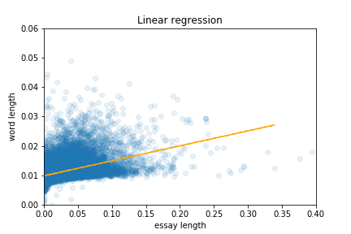
Results
Linear regression:
There is a slight tendency in having longer mean word length when writing longer essays
Slope = 0.05; intercept = 0.01; R² for training data = 18%; R² for testing data= 17%

Slide 21
Results
Multinomial regression:
The results for the pair ‘essay length’ and ‘education were:
Slope = –0.4, intercept = 1.9, R² training set = 0, R² testing set = 0
The results for the pair ‘mean word length’ and ‘education were:
Slope = 2.9, intercept = 1.9, R² training set = 0, R² testing set = 0

Slide 22
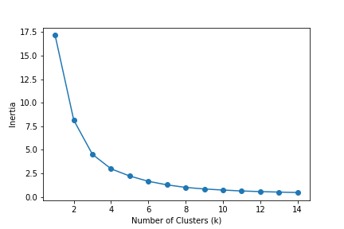
Results
Classification with K-Means++ cluster:
The inertia of the data (‘word mean length’ vs ‘essay length’ with label on ‘zodiac’) showed that a great number of centroids was the best option; here 12 was used to match the number of zodiac signs

Slide 23
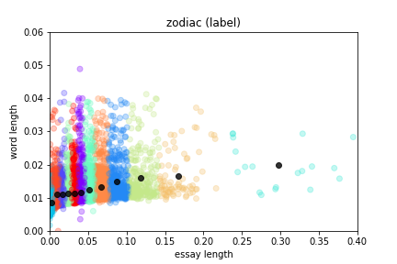
Results
Classification with K-Means++ cluster:
The outlook of the model was:

Slide 24
Results
Classification with K-Means++ cluster:
The performances of the model were:
Accuracy = 90%
recall (by label) =
1 2 3 4 5 6 7 8 9 10
0.197 0.0565 0.155 0.001 0.106 0.0289 0.169 0.104 0 0.0164
11 12
0.0013 0.213
precision (by label) =
1 2 3 4 5 6 7 8 9 10
0.080 0.087 0.108 0.022 0.105 0.080 0.010 0.080 0 0.082
11 12
0.050 0.083
f1 (by label) =
1 2 3 4 5 6 7 8 9 10
0.114 0.069 0.127 0.002 0.106 0.042 0.124 0.091 0 0.027
11 12
0.003 0.120

Slide 25
Results
Classification with support vector machine:
The performances of the model were:
Accuracy = 94%
recall (by label) =
1 2 3 4 5 6 7 8 9 10
0 0 0 0 1 0 0 0 0 0
11 12
0 0
precision (by label) =
1 2 3 4 5 6 7 8 9 10
0 0 0 0 0.094 0 0 0 0 0
11 12
0 0
f1 (by label) =
1 2 3 4 5 6 7 8 9 10
0 0 0 0 0.172 0 0 0 0 0
11 12
0 0

Slide 26
Results
Classification with K-Means++ cluster:
The inertia of the data (‘word mean length’ vs ‘essay length’ with label on ‘education’) showed that a great number of centroids was needed; here 4 was chosen to match the levels of education.

Slide 27
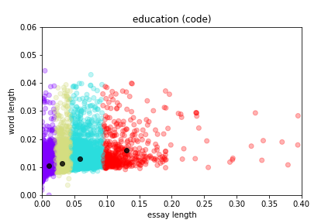
Results
Classification with K-Means++ cluster:
The outlook of the model was:

Slide 28
Results
Classification with K-Means++ cluster:
The performances of the model were:
Accuracy = 13%
recall (by label) =
1 2 3 4
0.336 0.718 0.097 0.013
precision (by label) =
1 2 3 4
0.037 0.050 0.860 0.055
f1 (by label) =
1 2 3 4
0.067 0.094 0.174 0.022

Slide 29
Results
Classification with support vector machine:
The performances of the model were:
Accuracy = 88%
recall (by label) =
1 2 3 4
0 0 1 0
precision (by label) =
1 2 3 4
0 0 0.881 0
f1 (by label) =
1 2 3 4
0 0 0.937 0

Slide 30
Discussion
Linear regression between continuous variables is quite straightforward and graphically easy to understand.
Multinomial regression requires more understanding of the data but is methodically as easy as linear regression thanks to the package used.
The accuracy of regression, not being a classification algorithm, is based on the coefficient of determination R². R² was small for linear regression indicating that there is not a strong association between writing long essays and long words.
When taking into account another variable – education level – the model did not improve, indicating that education level does not explain why people use longer essays or words.

Slide 31
Discussion
I have chosen K-Means Clustering because it is the the most popular and well-known clustering algorithm and does not make assumption on the data since it is unsupervised. Given the big overlap in the groups at hand, I preferred a method that find clusters without the prerequisite of knowing the label of the data before hand, as in the case of K-Nearest Neighbors.
I also chosen K-Means++ to improve the placing of the centroids.
I compared K-Means Clustering to support vector machine (SVM) because the latter is a powerful technique that is gaining momentum and I will be likely to use it in the future. Also, SVM is a supervised method, so I could see the differences in outcomes.
Both methods are easy to implement with Scikit-learn, but K-Means Clustering is easier to visualize than SVM and there is control on the number of clusters. Also, K-Means is faster to execute than SVM.

Slide 32
Discussion
In the classification of ‘education’ based on ‘essay length’ and ‘word length’, K-Means++ achieved an accuracy of 13% compared to 88% of SVM. Even in this case, SVM focused everything on a single class (3 = high level education).

Slide 33
Discussion
In particular, I did not have enough computer power to test different combinations of gamma and C.
Given the overlap between the groups, the number of clusters that reduced the inertia of the data was large (I set an upper limit at 15 and that was the best hit). In practice, I set the number of clusters to match the number of classes I was exploring. That is, k=12 for the twelve zodiac signs and k=4 for the education level.
In the classification of ‘zodiac sign’ based on ‘essay length’ and ‘word length’, K-Means++ achieved an accuracy of 90% compared to 94% of SVM. However the percentage of relevant items found (recall) was spread across all the classes with K-Mean++ but concentrated to a single class with SVM. Consistently, the percentage of items found that was relevant (precision) and the combination of these parameters (F1) followed the same pattern.
This behaviour can be explained because SVM defined two classes only thus a datum was either class 5 = virgo or not. Multiclass SVM was not covered in the course.

Slide 34
Conclusions
The question ‘is there an association between writing longer essays and longer words’ was answered by linear regression as ‘slightly’. Multi-nomial regression could not find another parameter that could explain the slight relation between these two variables.
K-Means++ classification methods could correctly classify a high proportion of data but with low relevance rate. SVM showed better accuracy and performances but was set to only two classes so, as was implemented, was not the right choice for the task.
The dataset was hampered by (1) too many categorical data, which are good for labelling but not to place points in a plane for clustering purposes; and (2) clusters too much overlapping.
The number of categories can also hamper the outcome of the analysis. Here I tried to use the least possible number of classes to simplify the analysis.

